Slide 1
Regular Expression
Anab Batool Kazmi

Slide 2
Regular Expression /Pattern
Method to define a language
Regular expressions is the algebraic description of a language i.e. a set of strings.
A regular expression, often called a pattern, is an algebraic expression used to specify a set of strings required for a particular purpose.
A regular expression is an expression not a language. It is used to generate a language.

Slide 3
Application
anywhere you need to check if a string matches a certain pattern and maybe extract certain information from that pattern.
Useful for validating inputs.
Useful in compiler construction
If the program code doesn’t match the regular expression compiler knows that there is a syntax error

Slide 4
Regular Expression
A regular expression (sometimes abbreviated to "regex") is a way for a computer user or programmer to express how a computer program should look for a specified pattern in text and then what the program is to do when each pattern match is found.
For example, a regular expression could tell a program to search for all text lines that contain the word "Windows 95" and then to print out each line in which a match is found or substitute another text sequence (for example, just "Windows") where any match occurs.
The best known tool for specifying and handling the incidence of regular expressions is grep, a utility found in Unix-based operating systems and also offered as a separate utility program for Windows and other operating systems.
Notes:
4

Slide 5
Regular Expression Operations
Union (+, U, | , v)
OR
(a+b) means either a or b
Concatenation (.)
AND
(ab) means both a and b
Kleene Star (*)
Kleene Plus (+)

Slide 6
Rules to Construct R.E
A Regular expression over a given alphabet Σ is constructed using the following rules:
^ (the empty string) is a regular expression.
L(^) = {^}
ϕ(the empty language) is a regular expression.
L(ϕ) ={ } OR {^}
Every symbol x in Σ is a regular expression.
If R1 and R2 are regular expressions:
R1 + R2 (the union of two regular expressions) is a regular expression.
L(R1+R2)=L(R1) U L(R2)
R1R2 (the concatenation of two regular expressions) is a regular expression.
L(R1R2)=L(R1).L(R2)
R1* (the star of a regular expression) is a regular expression.

Slide 7
Precedence of Operations
kleene > concatenation > union
For example
The expression a + b*c is grouped to (a + ((b)*c)).
The expression 01*+1 is grouped to (0(1)*)+1 .

Slide 8
Closure Properties
Kleene Star (*) /Kleene Closure
Kleene Plus (+) / Positive Closure
The Kleene Star indicates zero or more occurrence of preceding element.
Represented by “*”.
Example
If Σ={a} , define the language L1 of all strings including null.
L1={^, a, aa, aaa,…}
R.E(L1)= a*
The Kleene Plus indicates one or more occurrence of preceding element.
Represented by “+”.
Example
If Σ={a} , define the language L2 of all strings excluding null.
L2={a, aa, aaa,…}
R.E(L2)= a⁺

Slide 9
*
* = {0,1,2,3,….}
a^0= ^
a^2 =aa
a^3 =aaa
a* = { ^, a, aa, aaa,aaaa,… }
+
+ = {1,2,3,….}
a^+ ={ a, aa, aaa,aaaa,… }

Slide 10
Example
Find the regular expression for set of all strings whose length is exactly equal to 2, defined over Σ = {a, b}. .
Descriptive form:
L={aa,ab,ba,bb}
Regular Expression:
R.E(Σ)=aa+ab+ba+bb
=a(a+b)+b(a+b)
R.E=(a+b)(a+b)

Slide 11
Example
Find the regular expression for set of all strings whose length is exactly equal to 3, defined over Σ = {a, b}. .
Descriptive form:
L={aaa,aab,aba,abb,baa,bab,bba,bbb}
Regular Expression:
R.E(Σ)= aaa+aab+aba+abb+baa+bab+bba+bbb
=aa(a+b)+ab(a+b)+ba(a+b)+bb(a+b)
=(a+b)(aa+ab+ba+bb)
R.E=(a+b)(a+b)(a+b)

Slide 12
Example
Find the regular expression for set of all strings whose length is exactly equal to 4, defined over Σ = {a, b}?
R.E= (a+b).(a+b).(a+b).(a+b)
Find the regular expression for set of all strings whose length is exactly equal to 2, defined over Σ = {a, b, c}?
R.E= (a+b+c).(a+b+c)
Find the regular expression for set of all strings whose length is exactly equal to 2, defined over Σ = {a}?
R.E= aa

Slide 13
Example
Language L, consisting of all possible strings, defined over Σ = {a, b}. Descriptive form:
L={^,a,b,aa,ab,ba,bb,…}
Regular Expression:
R.E(Σ)=(a + b)*.
Language L, consisting of all possible strings, defined over Σ = {a}.
R.E =(a )*
Language L, consisting of all possible strings, defined over Σ = {a,b,c}.
R.E =(a+b+c )*

Slide 14
Language L, consisting of all possible strings, defined over Σ = {a, b}.
LENGTH = { 0,1,2,3,……}
LENGTH R.E = ^ = (a + b)^0
Length 1 R.E= a+b = (a + b)^1
Length 2 R.E= (a + b). (a + b) = (a + b)^2
Length 3 R.E= (a + b). (a + b) . (a + b)
R.E = (a + b)*

Slide 15
Language L, consisting of all possible strings EXCLUDING NULL, defined over Σ = {a, b, c}.
R.E = (a + b + c)^+

Slide 16
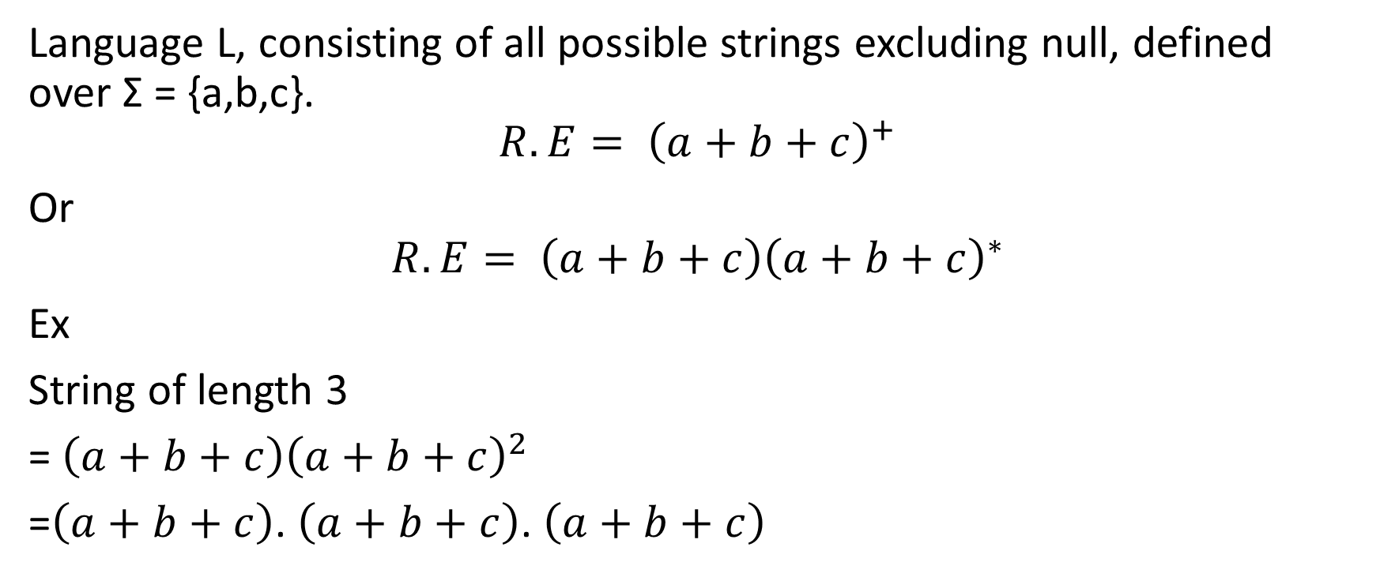
Language L, consisting of all possible strings excluding null, defined over Σ = {a,b,c}.
$$R.E= {\left(a+b+c\right)}^{+}$$
Or
$$R.E= {\left(a+b+c\right)\left(a+b+c\right)}^{∗}$$
Ex
String of length 3
=${\left(a+b+c\right)\left(a+b+c\right)}^{2}$
=$\left(a+b+c\right)$. $\left(a+b+c\right)$. $\left(a+b+c\right)$

Slide 17
Example
Find the regular expression for set of all strings whose length is atleast equal to 2, defined over Σ = {a, b}.
Descriptive form:
L={aa,ab,ba,bb ,aaa,aab,aba,abb,baa,bab,bba,bbb,…}
Regular Expression:
R.E(Σ)=(a+b)(a+b) (a+b)*
(a+b)(a+b)(a+b)^0 =(a+b)(a+b).^
(a+b)(a+b)(a+b)^1= (a+b)(a+b)(a+b)
(a+b)(a+b)(a+b)^2=(a+b)(a+b)(a+b)(a+b)

Slide 18
Example
Find the regular expression for set of all strings whose length is atmost equal to 2, defined over Σ = {a, b, c}.
Descriptive form:
L={^,a,b,c,aa,ab,ac,ba,bb,bc,ca,cb,cc}
Regular Expression:
R.E(Σ)=(a+b+^+c)(a+b+^+c)

Slide 19
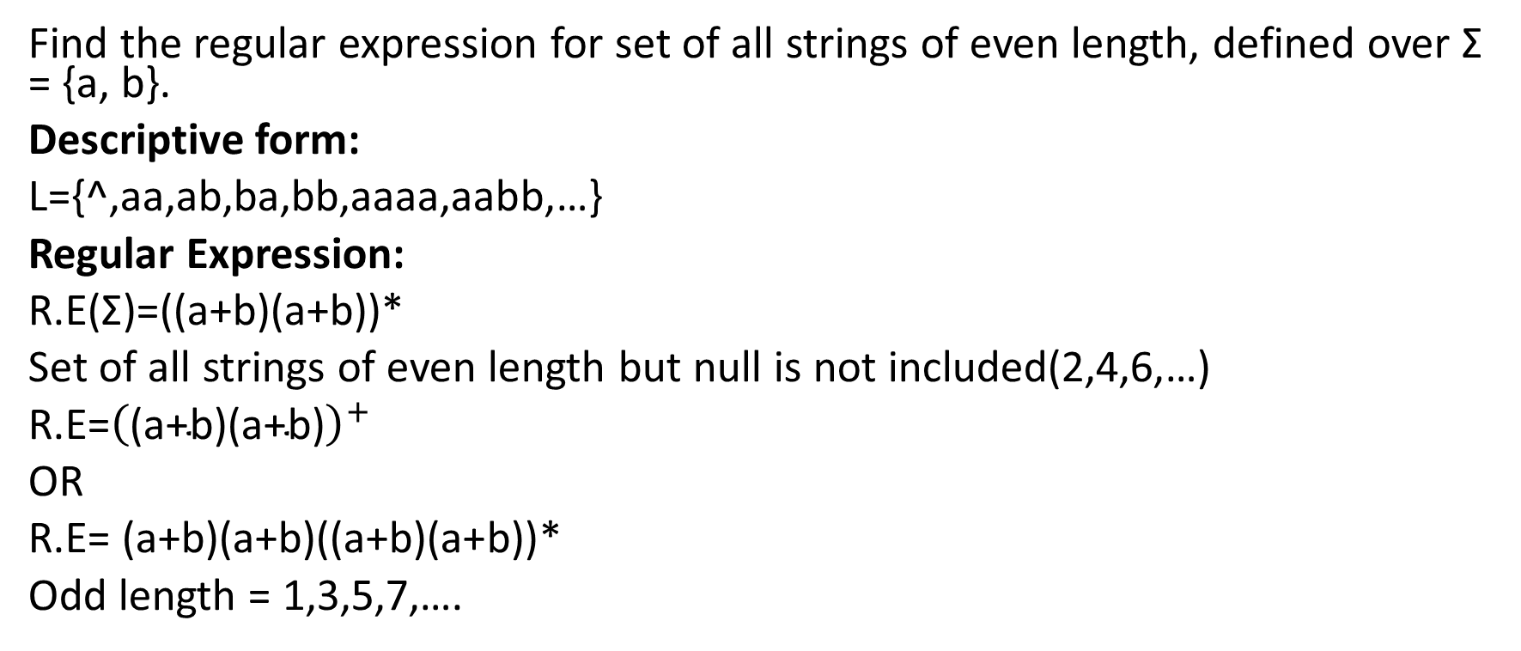
Example
Find the regular expression for set of all strings of even length, defined over Σ = {a, b}.
Descriptive form:
L={^,aa,ab,ba,bb,aaaa,aabb,…}
Regular Expression:
R.E(Σ)=((a+b)(a+b))*
Set of all strings of even length but null is not included(2,4,6,…)
R.E=${\left(\text{(}\text{a}\text{+}\text{b}\text{)(}\text{a}\text{+}\text{b}\text{)}\right)}^{+}$
OR
R.E= (a+b)(a+b)((a+b)(a+b))*
Odd length = 1,3,5,7,….

Slide 20
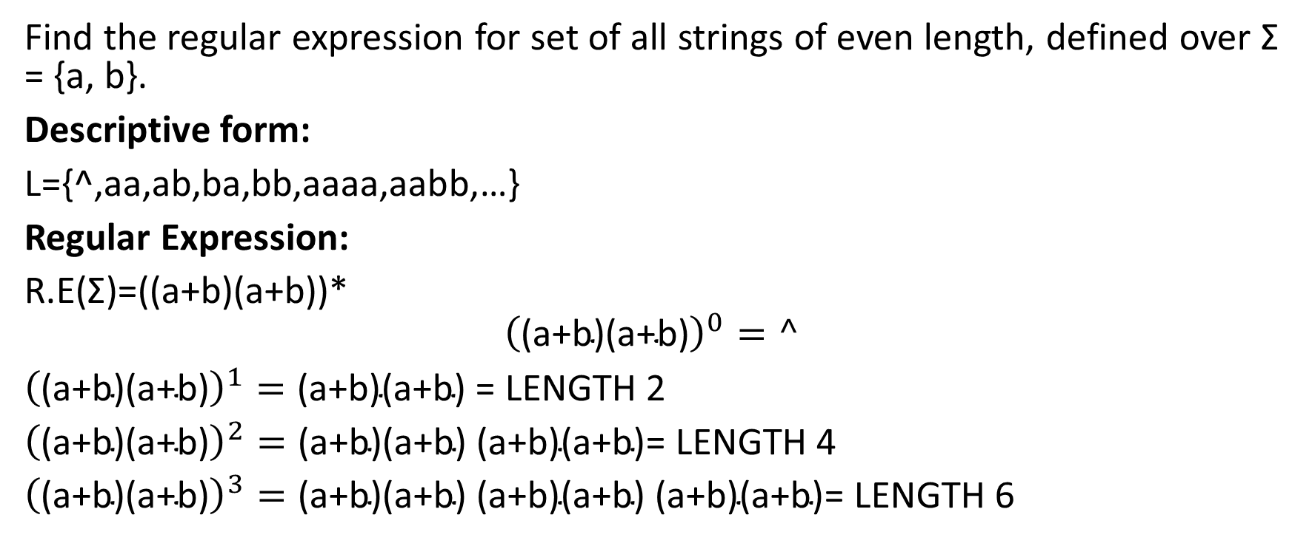
Find the regular expression for set of all strings of even length, defined over Σ = {a, b}.
Descriptive form:
L={^,aa,ab,ba,bb,aaaa,aabb,…}
Regular Expression:
R.E(Σ)=((a+b)(a+b))*
$${\left(\text{(}\text{a}\text{+}\text{b}\text{)(}\text{a}\text{+}\text{b}\text{)}\right)}^{0}=^$$
${\left(\text{(}\text{a}\text{+}\text{b}\text{)(}\text{a}\text{+}\text{b}\text{)}\right)}^{1}=\text{(}\text{a}\text{+}\text{b}\text{)(}\text{a}\text{+}\text{b}\text{)}$ = LENGTH 2
${\left(\text{(}\text{a}\text{+}\text{b}\text{)(}\text{a}\text{+}\text{b}\text{)}\right)}^{2}=\text{(}\text{a}\text{+}\text{b}\text{)(}\text{a}\text{+}\text{b}\text{)}$ $\text{(}\text{a}\text{+}\text{b}\text{)(}\text{a}\text{+}\text{b}\text{)}$= LENGTH 4
${\left(\text{(}\text{a}\text{+}\text{b}\text{)(}\text{a}\text{+}\text{b}\text{)}\right)}^{3}=\text{(}\text{a}\text{+}\text{b}\text{)(}\text{a}\text{+}\text{b}\text{)}$ $\text{(}\text{a}\text{+}\text{b}\text{)(}\text{a}\text{+}\text{b}\text{)}$ $\text{(}\text{a}\text{+}\text{b}\text{)(}\text{a}\text{+}\text{b}\text{)}$= LENGTH 6

Slide 21
Example
Find the regular expression for set of all strings of odd length, defined over Σ = {a, b}.
Descriptive form:
L={a,b,aaa,aab,aba,…}
Regular Expression:
R.E(Σ)=(a+b)((a+b)(a+b))*

Slide 22
Example
Language L, of strings having exactly one a, defined over Σ = {a, b}.
Descriptive form:
L={a,ab,ba,abb,bab,…}
Regular Expression:
R.E(Σ)=b*a b*.

Slide 23
Example
Language L, of strings having atleast one a, defined over Σ = {a, b}.
Descriptive form:
L={a,aa,ab,ba,aaa,aab,aba,abb,baa,bab…}
Regular Expression:
R.E(Σ)= (a + b)* a (a + b)*

Slide 24
Example
Language L, of strings having all the words that begin with a, followed by anything (i.e., as many choices as we want of either a or b) , defined over Σ = {a, b}.
Descriptive form:
L={a,aa,ab,abb,aba,…}
Regular Expression:
R.E(Σ)= a(a + b)*.

Slide 25
Example
Language L of strings of a’s and b’s ending with the string abb.
Descriptive form:
L= {abb, aabb, babb, aaabb, ababb, …………..}
Regular Expression:
R.E(Σ)=(a+b)*abb.

Slide 26
Example
Language L of strings consisting of even number of 1’s including empty string.
Descriptive form:
L= {^, 11, 1111, 111111, ……….}
Regular Expression:
R.E(Σ)=(11)*

Slide 27
Set of strings consisting of even number of a’s followed by odd number of b’s .
Descriptive form:
L = {b, aab, aabbb, aabbbbb, aaaab, aaaabbb, …………..}
Regular Expression:
(aa)*(bb)*b

Slide 28
Equivalent Regular Expressions
Two regular expressions are equal if they generate the same language.
Example:
Consider the following regular expressions
r1 = (a + b)* (aa + bb)
r2 = (a + b)*aa + ( a + b)*bb
both regular expressions define the language of strings ending in aa or bb.

Slide 29
Regular Expressions and Programming Languages
An identifier in the C programming language is a string of length 1 or more that contains only letters, digits, and underscores (“ _”) and does not begin with a digit.
int _num123NUM _123; // where num is an identifier
l is R.E for “letter,” either uppercase or lowercase
l=a + b + c + . . . + z + A + B + . . . + Z
d is R.E for “digit”
d=0 + 1 + 2 + ·· ·+9
R.E for the language of C identifiers is
(l +_ )(l + d +_ )*

Slide 30
An identifier in the C programming language where length of identifier is exactly equal to 4.
R.E = (l +_ )(l + d +_ ) (l + d +_ ) (l + d +_ )

Slide 31
Variable declaration in c$$ programming language.
Set of allowed data types= char, int, float
Syntax for variable declaration
Datatype identifier$;
dT = char + int + float
Sp = SPACE
iD =(l +_ )(l + d +_ )*
R.E(Var Declaration) = dT.sP.iD.$.;

Slide 32
Int var1$,var2$;
Int var$,;
dT = char + int + float
Sp = SPACE
iD =(l +_ )(l + d +_ )*
R.E= dT.Sp.iD$.(,ID$)*;
dT.Sp.iD$.(,ID$)^1;
Int var1$, var2$;

